Slide 1
Collective Com., DIViA and MPI-2
B.Arunachalam
System Software Development Group,
C-DAC,KP Bangalore

Slide 2
Presentation Outline
Introduction
MPI Collective Communication calls
DIViA tool
MPI- 2 Overview
Dynamic Process Management
Parallel I/O
Conclusion

Slide 3
Introduction
  Involves the sending and receiving of data among processes
  All processes need to participate in the communication.
  Usage of Point-to-point communication routines
  Customized communicator
  No message tags used

Slide 4
Collective Communications
  Only Blocking; standard mode
  Simple variant or ‘vector’ variant
  Some collectives have ‘root’s
  Different types
    One-to-All
    All-to-One
    All-to-All

Slide 5
Collective Operations
Three classes of collective operations:
  Synchronization (Ex: Barrier synchronization)
  Data movement (Ex: Broadcast, Scatter, Gather)
  Collective computation (Ex: SUM, MAX, MIN, etc)

Slide 6
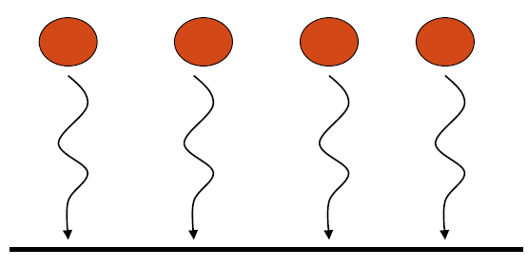
MPI Collective Communication - Barrier
Barrier:
A barrier ensures that all processes reach a specified location within the code before continuing.
  C: int MPI_Barrier (comm);
  Fortran: MPI_barrier (comm, ierror)

Slide 7
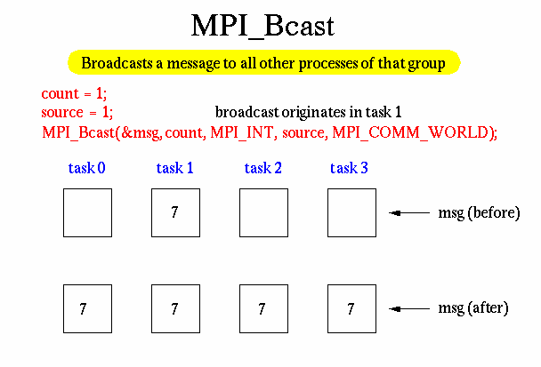
MPI Collective Communication - Broadcast

Slide 8
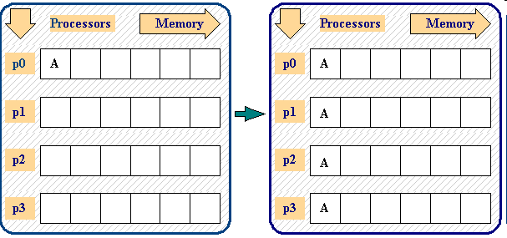
MPI Collective Communication – Broadcast (another sample)

Slide 9
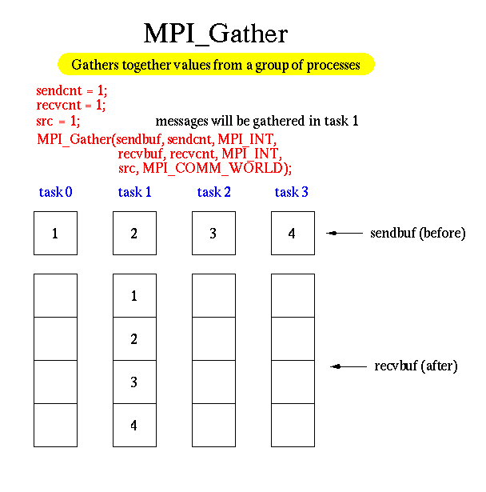
MPI Collective Communications- Gather

Slide 10
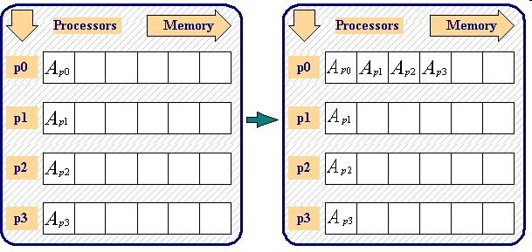
MPI Collective Computation – Gather (another sample)

Slide 11
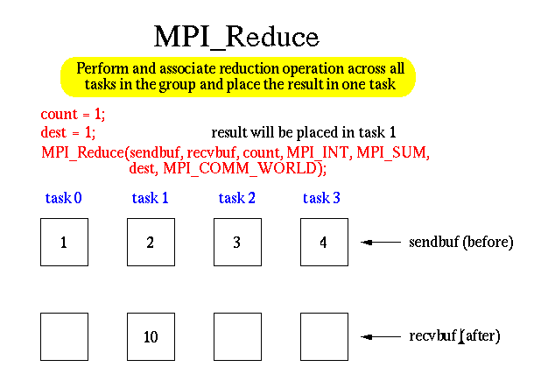
MPI Collective Computation - Reduce

Slide 12
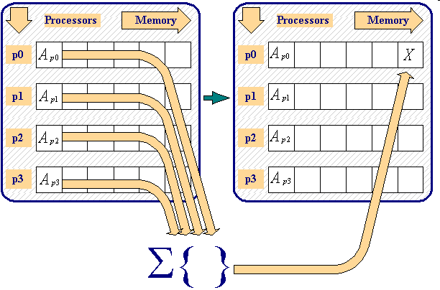
MPI Collective Computation – Reduce (another sample)

Slide 13
MPI Collective Computations - Reduce
(Contd…)
Collective Computation Operation:
MPI Name
Operation
MPI_MAX
Maximum
MPI_MIN
Minimum
MPI_PROD
Product
MPI_SUM
Sum
MPI_MAXLOC
Maximum and location

Slide 14
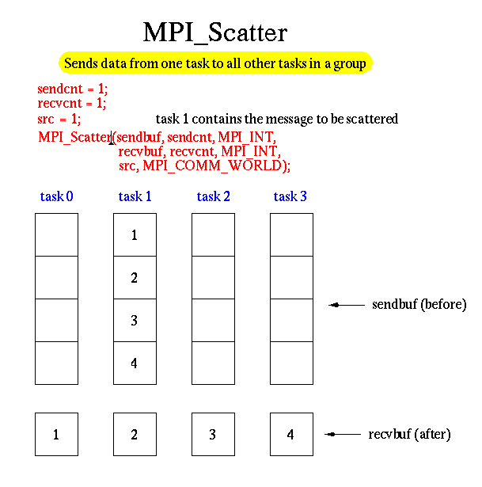
MPI Collective Communications – Scatter

Slide 15
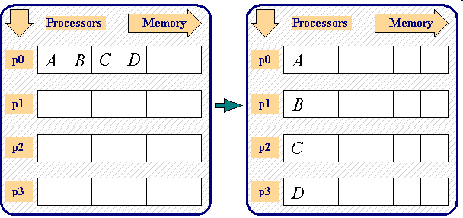
MPI Collective Computation – Scatter (another sample)

Slide 16
Advanced Operations
MPI_ALLREDUCE —All group members receives the combined value
User-Defined Reduction Operations — enable reduction to be defined as an arbitrary operation.
MPI_GATHERV and MPI_SCATTERV allow a varying count of data from/to each process.
MPI_ALLGATHER and MPI_ALLTOALL
  No root process specified: all processes get gathered or scattered data. Send and receive arguments are meaningful to all processes.
MPI_SCAN — used to carry out a prefix reduction on data throughout the group and returns the reduction of the values of all of the processes.
MPI_REDUCE_SCATTER combines an MPI_REDUCE and an MPI_SCATTERV.

Slide 17
Tools Available - DIViA
DIViA – Debugger with Integrated Visualizer and Analyzer
  Supports C and Fortran MPI applications.
Components of DIViA
  Correctness Debugger
  Performance Debugger
TotalView parallel debugger tool

Slide 18
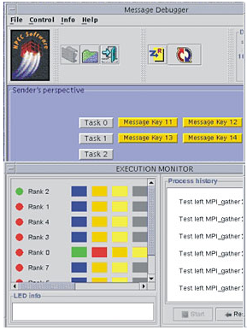
DIViA - Correctness Debugger
Ability to debug constituent tasks of a parallel and distributed application from a single control point
Supports the dynamic generation of task groups
Parallel analogy to frequently used sequential debugger commands

Slide 19
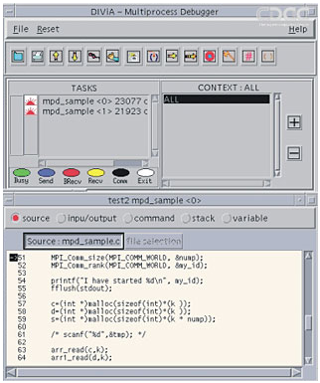
DIViA - Correctness Debugger
Communication and execution oriented process status display
Selective debugger control of dynamically created tasks
Symbolic, interactive source code debugger for individual task

Slide 20
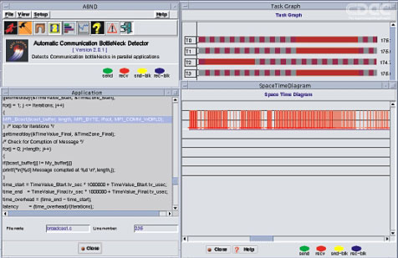
DIViA – Performance Debugger (Profiler)
Provision to hierarchically pinpoint the actual region of bottleneck
Minimum perturbation to the user application because traces are generated only for the selected task and selected regions
Task Graph to know the details of each task's communication
Source Code View corresponding to the event in the bottleneck region

Slide 21
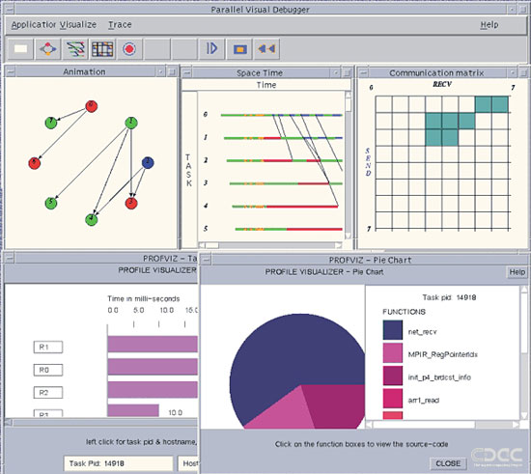
DIViA – Performance Debugger (Profiler)
Space Time Diagram to see the communication events in the bottleneck region
Static instrumentation method to collect event traces
Independent trace collection and analysis

Slide 22
MPI-2 Overview
❖ Extensions to the message-passing model
➢ Parallel I/O
➢ One-sided operations
➢ Dynamic process management
 Making MPI more robust and convenient
➢ C++ and Fortran 90 bindings
➢ External interfaces, handlers
➢ Extended collective operations
➢ Language interoperability
➢ MPI interaction with threads

Slide 23
MPI-2 Origins
 Began meeting in March 1995, with
➢ veterans of MPI-1
➢ new vendor participants
 Goals:
➢Extend computational model beyond message-passing
➢Add new capabilities
➢Respond to user reaction to MPI-1
 MPI-1.1 released in June, 1995 with MPI-1 repairs,some bindings changes
 MPI-1.2 and MPI-2 released July, 1997
 Implementations appearing, bit by bit

Slide 24
Dynamic Process Management
Allows an MPI job to spawn new processes at
run time and communicate with them
Allows two independently started MPI applications to
establish communication

Slide 25
Starting New MPI Processes
In parents
In children
MPI_Comm_world
MPI_Comm_spawn
MPI_Init
Any
communicator
Parent intercommunicator
New intercommunicator

Slide 26
Starting New MPI Processes
MPI_Comm_spawn(command, argv, numprocs, info,root,comm,intercomm,errcodes);
❖ Tries to start numprocs process running command,
❖ The operation is collective over comm.
❖ Spawnees are in remote group of intercomm
❖ Errors are reported on a per-process basis in errcodes
❖ Info used to optionally specify hostname, archname
wdir, path, file, softness

Slide 27
Spawning Multiple Executables
❖ MPI_Comm_spawn_multiple (...)
❖ Arguments command, argv, numprocs, info all
become arrays,.
❖ Still collective

Slide 28
In the Children
❖ MPI_Init (only MPI Programs can be spawned)
❖ MPI_COMM_WORLD is processes spawned with one
call to MPI_Comm_spawn .
❖ MPI_Comm_get_parent obtains parent intercommunicator
➢ same as intercommunicator returned by MPI_Comm_spawn
in parents
➢ Remote group is spawners
➢ Local group is those spawned

Slide 29
Extended Collective Operations
❖ In MPI-1, collective operations are restricted to ordinary
(intra) communicators.
❖ In MPI-2, most collective operations apply also to inter- communicators, with appropriately different semantics.
❖ E.g, Bcast/Reduce in the intercommunicator resulting from spawning new processes goes from/to root in spawning processes to/from the spawned processes
❖ In-place extensions

Slide 30
Extensive Collective operations
❖ Issues
➢ maintaining simplicity, flexibility, and correctness
Interaction with operating system, resource manager,
and process manager
➢ connecting independently started processes
  Spawning new processes is collective, returning an intercommunicator
➢ Local group is group of spawning processes.
➢ Remote group is group of new processes.
➢ New processes have own MPI_COMM_WORL
➢ MPI_Comm_get_parent lets new processes find par communicator

Slide 31
MPI Inter-communicators (1)
v  Contain a local group and a remote group
❖ Point-to-point communication is between a process in one group and a process in the other.
v  Can be merged into a normal (intra) communicator
v  Created by MPI_Intercomm_create in MPI-1.
❖ Play a more important role in MPI-2, created in multiple ways.

Slide 32
MPI Inter-communicators (2)
Send(1)
Send(2)
Local group
Remote group

Slide 33
One-Sided Communications Calls
➢ MPI_Put – stores into remote memory
➢ MPI_Get – reads from remote memory
➢ MPI_Accumulate – updates remote memory
➢ All are non-blocking: data transfer is described, may
be even initiated, but may continue after call returns.
➢Subsequent synchronization on window object is needed to ensure operations are complete.

Slide 34
Put, Get, and Accumulate
❖ MPI_Put(origin_addr,origin_count, origin_datatype, target_addr, target_count, target_datatype, window)
❖ MPI_Accumulate(..., op, ...)
❖ op is an in MPI_Reduce, but no user-defined operations are allowed.
❖ MPI_Get(...)

Slide 35
What is Parallel I/O?
Multiple processes of a parallel program accessing data
(reading or writing) from a common file
Alternatives to parallel I/O:
  All processes send data to rank 0, and rank 0 writes it to a file
  Each process opens a separate file and writes to it

Slide 36
Why Parallel I/O?
Non-parallel I/O is simple but
  Poor performance (single process writes to one file) or
  Awkward and not interoperable with other tools (each
  process writes a separate file)
  Parallel I/O
  Provides high performance
  Can provide a single file that can be used with other tools (such as visualization programs)

Slide 37
Non-Parallel I/O from an MPI
❖ First example: non-parallel I/O (Sequential) from an MPI program
Memory
process
file

Slide 38
Non-MPI parallel I/O
 Each process writes to a separate file
Memory
process
file
❖ Pro: parallelism
❖ Con: lots of small files to manage

Slide 39
MPI Vs UNIX I/O
Unix
MPI
FILE myfile;
MPI_File myfile;
myfile=fopen(…)
MPI_File_open(...)
takes info, comm
args
fread(...)
MPI_File_read/write(...)
take(addr, count,datatype)
fwrite(...)
MPI_File_close

Slide 40
MPI Parallel I/O to Single File
❖ Processes write to shared file
MPI_File_set_view assigns regions of the file to separate processes

Slide 41
Singleton MPI_Init
❖ An “ordinary” process may become an MPI
process by calling MPI_Init.
➢ MPI_Comm_World then consists only of the one process
➢ The process could then use MPI_Spawn to create other
processes and communicate with them
❖ Recommended, not required, in MPI-2

Slide 42
Establishing Connections Between Parallel Programs
In server
In client
MPI_Connect
MPI_Accept
New intercommunicato r

Slide 43
Language Interoperability
  Singleton MPI_Init
  Passing MPI Objects between languages
 Constant values, error handlers
  Sending in one language; receiving in another
  Addresses
  Datatypes
  Reduce operations

Slide 44
Conclusion
  MPI helps for Portable parallel Program Development
  Rich set of collective functions
  MPI helps for developing Scalable Parallel Programs
  MPI-2 provides major extensions to the original message passing model targeted by MPI-1
  MPI-2 can deliver to libraries and applications portability across a diverse set of environments.

Slide 45
Exercise
1. Write an MPI program that has a total of 4 processes. Process with rank 1, 2 and 3 should
send the following messages respectively to the process with rank 0: CDAC, ACTS, DSSD
2. Debugging exercise: Write a program to send a message from rank 0 process to rank 1 process.
The message needs to be sent in a variable called "Message". But the Message variable should
not be filled within the program. The Message variable needs to be filled in from gdb. The message
to be sent is "CDAC“
3. Write an MPI program that has a total number of 4 processes. The process with rank 0 should send
ACTS letter to all the processes using MPI_Scatter call
4. Write an MPI program to find maximum value in array of six integers with 6 processes and print the
result in root process using MPI_Reduce call

Slide 46
Thank You.

